Slide 1

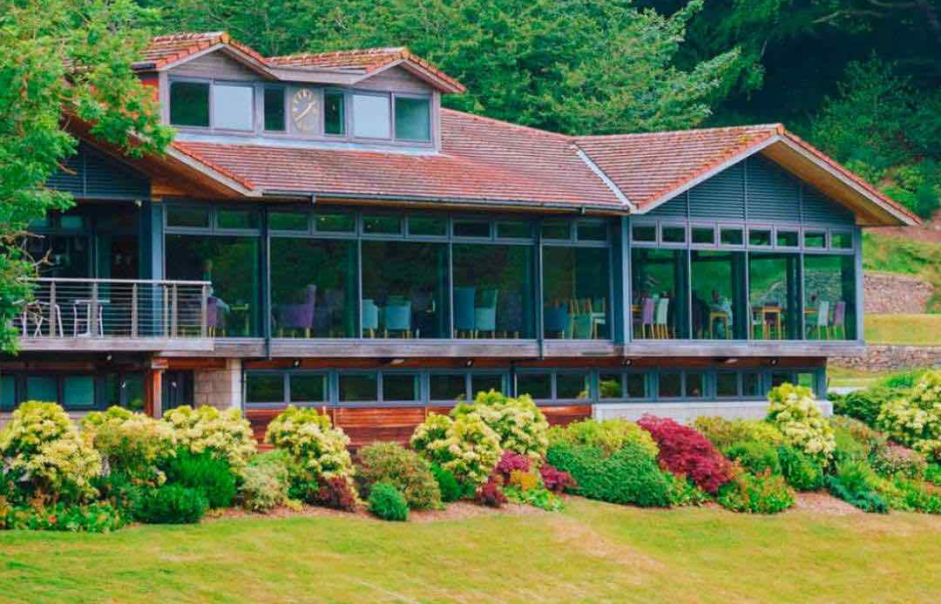
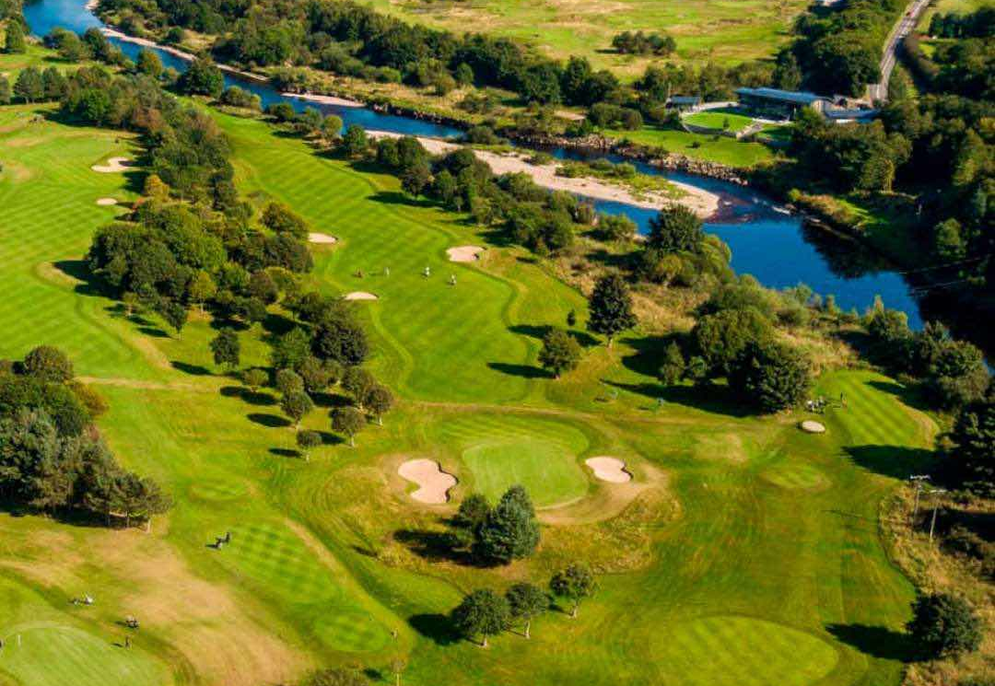
STRATEGIC
STRATEGIC PLAN 2026-2030 – Q&A
2026-2030

Slide 2
Q&A Courses
 | Question | Answer
1. | What are the priority actions for ensuring the courses are presented at their best? | To follow our annual maintenance plans to keep the grass plants as healthy as possible. If we can continue to improve the grass types, the refinement of the grass plant and its health then presentation levels will continue to improve. We will continue to protect areas of the courses during the winter and when the ground is softer to reduce damage to the grass plant.
2. | Are there any plans to change the course layout? | The feedback from members has predominantly been to not make more changes to the course design and avoid further disruption. The bunker redesign has been successful but will still be ongoing for a further one to two years. There are no other obvious changes to the course design that would not result in further disruption of negative impacts else where.
3. | Is the club doing as much as it can on flood mitigation? | Yes, all the recommendations proposed by CBEC are being reviewed however some require SEPA approval. CBEC are one of the UK’s leading environmental engineering consultants for solutions for the aquatic environment.
4. | Are there any contingency plans for trees that may be at risk. | We have instructed EDI (Course Architects) to look at a long-term plan for the 13th, 15th and 18th holes for when tree health becomes an issue. They are working alongside our Arboriculturists who inspects the trees on an annual basis. We will follow the arborists yearly plans to try a prolong the life of the trees.
5. | Are there any other significant risks? | Yes, the lining for the pond on the 9th hole is around 30 years old and beyond its expected life. However, it continues to be effective but would be a significant cost to replace.
6. | Are there plans to reduce the gradient of the exit paths on the finishing holes of both courses. | Building of a path coming from the 9th off the Blairs course will happen this winter. This will change the gradient from 1 in 4 to a 1 in 7. Players from the Haughton course will also have access to this path but they will have to walk further. Options for a lower incline path from the Haughton 18th green to the clubhouse have not identified any suitable options.
7. | Are there further investments in robotic mowers contemplated | We have 7 robotic mowers, with the latest 3 mowers being installed in July. The robotic mowers are designed to cut the Rough. The use of these mowers have improved the grass quality and the aesthetics, which has released the green keeping staff to spend more time on critical areas on course maintenance and improvements. We will continue to consider additional mowers, however there are security concerns with the mowers when they operate near public footpaths. We are fortunate that to date we have had no security incidents with the mowers during their annual operations from March to October.
8. | Are there any significant health and safety concerns that need addressed? | We continually monitor all health and safety concerns and address them as soon as possible.

Slide 3
Q&A Golf Operations
 | Question | Answer
1. | Why are there no specific plans to increase visitor income? | While visitors are welcome at Deeside and we have improved the booking access on the website, our priority focus is on the membership and we do not want to reduce the playing time available to members by allocating more times available for visitors
2. | How can we further enhance the driving range experience? | We have already taken steps to significantly enhance the driving range with the introduction of trackman at no additional cost to members. The range has an exceptionally high usage ratio per bay. We are looking to enhance the range area with new targets and are looking at the potential for an additional outdoor bay but there is no practical space to include grass bays. Further indoor development will come at a significant cost and is not a priority at this time.
3. | Does the club benefit from having such a high number of junior members? | The club is very proud of the golfing experience it provides its junior members and how popular Deeside as a club for juniors to join. There are significant long-term benefits to the club by having a big focus on the junior section as this will help support membership numbers in the future. Not only will a proportion of junior members become adult members, but their parents and family are also keen to join evidenced by an increasing healthy waiting list.
4. | Does the pro-shop really need a new layout? | The plans to change the layout of the pro-shop are well in hand and should not result in a significant capital outlay. It is important that the pro-shop has adequate space for the stock we want to sell and that the pro-shop team have suitable space for working and the changes seek to address these issues.
5. | Should the club be doing more on social media? | Most clubs utilise their socials to encourage visitors to play their courses & obtain membership leads. Currently Deeside has a very healthy waiting list & is not actively seeking visitors. Whilst it is nice having an active social media, this requires considerably time and is currently not a priority.
6. | Is the pricing in the shop competitive with alternative options? | Twice a year a member of the Professional Shop team will complete price comparisons against the main online retailers. We are certainly competitive with hardware in which members have the opportunity to get Professionally fitted, take the club onto the course, 2% loyalty on spends over £100 & aftersales service. Shoes is often dependent on whether an online store is offering a sale however our price comparisons would suggest we are competitive. Deeside offers the logo on most garments which comes at an additional cost compared to online. Once 10% discount is given we are often matching or under online,

Slide 4
Q&A Club Operations
 | Question | Answer
1. | Should there not be more discounted meals on offer? | Our objective for the bar and restaurant is to have a pricing strategy for the benefit of members while maintaining an appropriate financial contribution. There are many examples of golf clubs who have simply failed to manage an effective catering option, and many have outsourced which comes with its own issues. It is therefore vital that we have a policy that ensures acceptable margins are achieved. The current pricing and volume of traffic allows the club to almost cover the wages and salaries of bar and restaurant staff, however there is still a small loss after salary costs. Currently our pricing is competitive with other local establishments and in most cases lower after the members’ discount. If we did offer higher discounts, we would likely need to increase subscriptions or reduce spend elsewhere, such as on the course. The ambience and surroundings that Deeside offers delivers a premium experience above your average golf club and at competitive prices with local establishments.
2. | What are the plans for the outside area and the marquee? | The balcony and railings will be replaced, along with a new ramp down the side of the building, this will ease the congestion and trip risk at the front door which is still subject to approving costs to implement this improvement. Plans to upgrade the outside area are at an early stage, however the furniture will be replaced in Spring 2026.
3. | What are some examples of unacceptable membership etiquette and expected standards at the Club? | Not raking bunkers, not repairing pitch marks, not keeping up with the group in front, not wearing appropriate golfing attire, not treating fellow members and staff with the required respect, knowledge of the rules, late payment of fees, lack of attention to notifications, general golf course/practice facilities and clubhouse etiquette.
4. | What are members benefits? | A full list of member benefits are available on the website, these include Golfing/Clubhouse/Pro Shop/Reciprocals etc.
5. | Are there adequate plans in place for staff training and development? | Both internal and external staff training is carried out annually. External training is carried out by CMAE (Club Managers Association of Europe), Hospitality training (Aberdeen) and CCL (Contemporary Club Leadership) Internal training is carried out by Heads of Department.
6. | Will the Club consider becoming GEO certified | Yes, the Club will consider GEO certification after detailed discussions with other GEO certified clubs to ensure it is something Deeside want to pursue. (Note: GEO Certified means implementing good sustainable practices i.e. use of water, energy etc.)
7. | Are there any opportunities for cost savings? | The investment in robotic mowers has delivered opportunities for cost savings both in terms of staff numbers and in costs of fuel. The replacement of the HVAC system and the change to LED. Lighting during the clubhouse refurbishment should deliver annual saving on energy usage. Council are considering the installation of Solar panels and batteries. The Clubhouse Energy savings are monitored annually within the remit of the existing contracts. Clubhouse purchasing (F&B) is monitored monthly ensuring that the Club are receiving the best deal from local suppliers.

