Slide 1


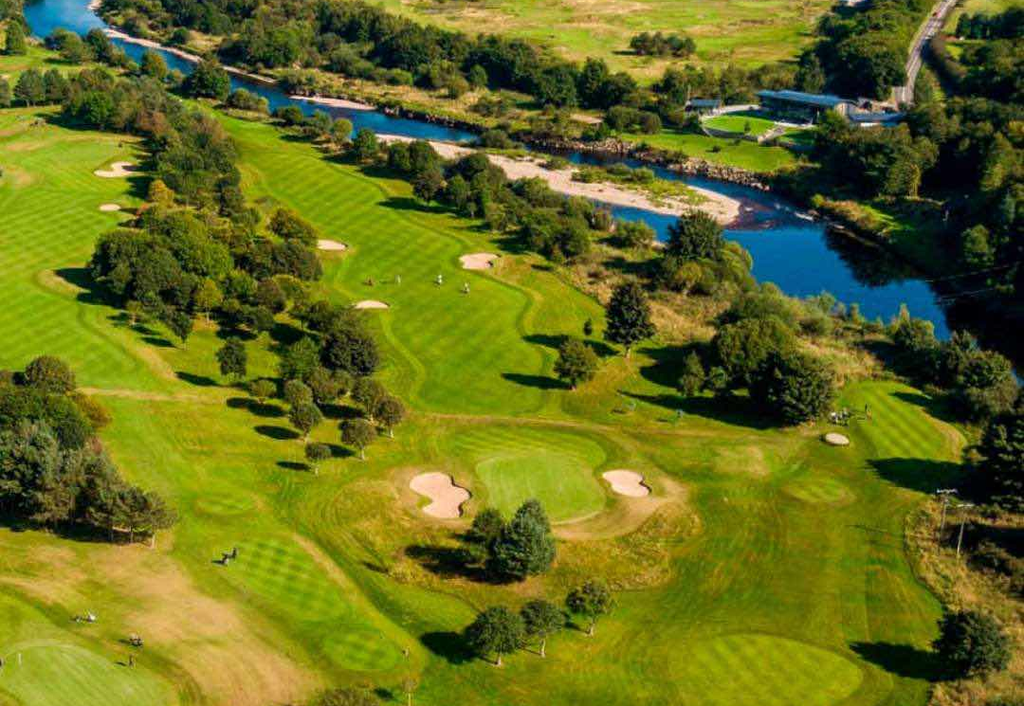
STRATEGIC PLAN
2026-2030

Slide 2
Captains Foreword & Introduction
On behalf of council, I am delighted to present Deeside Golf Club’s Strategic Plan for 2026-2030.
The Plan builds on our recent achievements and outlines how the club will evolve and and succeed in delivering an enhanced member experience over the next five years.
Our recent achievements include significant progress towards completion of the bunker improvement programme, investment in autonomous mowers and sand injection equipment, the installation of Trackman in the driving range and the completion of the main phases of the clubhouse refurbishment.
Over the next five years we plan to further enhance the member experience on and off the golf course through a series of initiatives which are set out in this plan. We will focus the plan on three core areas of the club being:
The Courses and practice areas.
Golf Operations in the driving range.
The Clubhouse & outdoor facilities.
Our plan will have 5 underpinning objectives being:
Service Excellence.
Finance.
Sustainability.
Talent Management.
Governance.
I would like to thank the Strategy Committee for their efforts in putting this plan in place and everyone else that has made a contribution along the way. I look forward to your support in delivering this plan which has the aim to provide all members, guests and visitors with an exceptional user experience.

Slide 3
Mission and Vision Statements
Defining our purpose and aspirations
Mission Statement
To provide an exceptional golfing and social experience in a welcoming members club environment.
Vision Statement
To be recognized as one of the premier golf clubs in Scotland, known for our excellent facilities and member experience.

Slide 4
Strategic Plan Structure
Core areas of focus
Course
Pro-Shop
Driving Range
Coaching
Competition Golf
Club Operations
Membership
Food and Beverage Service
Locker rooms and office services
Marquee, outdoor area, parking
Golf operations
Haughton
Blairs
Practice Areas
Paths and boundaries
Service Excellence
Finance
Sustainability
Talent Management
Governance

Slide 5
Defining our Core areas of focus
The Courses include the Haughton and Blairs courses as well as the practice areas, access paths and boundaries.
Golf operations include the Pro-shop, the driving range (now incorporating trackman), coaching facilities and competition golf.
Club Operations includes membership and administration, the food and beverage service, locker rooms, the Marquee and outdoor facilities, access roads and parking.

Slide 6
Defining our 5 governing objectives
Service Excellence - providing a high-quality user experience that exceeds expectations through understanding membership needs and providing a high-quality service consistently.
Finance - achieving a modest net profit annually to provide funds for reinvestment and ensure appropriate cash reserves are in place to provide long term stability.
Sustainability – balancing the economic, environmental and social goals by creating an attractive environment, embracing new technology, focus on energy efficiency, adapting to climate changes, and maintaining membership levels.
Talent Management – ensure that we have a high-quality team by attracting, training and retaining the best people and providing suitable career paths for all staff.
Governance – having the appropriate system of processes and policies for the smooth running of the golf club, where there is regular and open communication, a focus on health and safety and a high level of integrity, fairness and respect for members and staff alike.
Notes:
Long

Slide 7
The Process
Appoint Sub-Committee including members of council and other members
Review Past Achievements, consider SWOT analysis and draft financial plan
Engage with key people to formulate key initiatives and update financials if required
Finalise the Strategic Plan and communicate with members
Council agree process and timeframe

Slide 8
Strategy Sub-committee
Strategy Sub-committee
Chris Watson (Chair) –Full Member
Janice Gove - Senior Member
David Rennie – Honorary Member
Kevin Willox – Associate Member
Peter Reilly –Full Member
Council
Management
Debbie Pern, Club Manager
Neil McLoughlin, Course Manager
Graeme Nethercott Head PGA Pro
The Strategy Sub-committee will meet with the management team and others as required to formulate the strategic plan
The Strategy Sub-committee will communicate the strategic plan to council who will review, feedback and approve

Slide 9
Initiatives in the past 5 years
Course | Golf Operations | Club Operations
Bunker redesign program – easier maintenance and improved design | Inhouse professional team development | Clubhouse Refurbishment
Autonomous mowers – improve grass health,presentation and cost reduction | Trackman installation | Marquee and outdoor areas
Equipment upgrades – sand injection, bunker rakes, winter mats | Coaching expansion | New club website
Health and safety – new paths (1st and 15th tee on Haughton and 1st on Blairs) | Competition and social golf improvements | Reduce average age of membership and increase younger/associate members
Flood mitigation work – clearing swales, new drainage, etc. | Junior and ladies’ programmes | Increase locker/trolley capacity and procure buggies
Greenkeeping shed | Pro-shop stock purchasing around members habits | Customer Service initiatives (Menu, Club59, Deeside Way)
STRI Maintenance programme | Custom fitting | Update rules and regulations and admin structure
Course Policy Document updates | Implemented loyalty programme

Slide 10
Assessment of current status- internal view
Strengths
Member Satisfaction
Design/Condition of Courses (much improved)
Investment in high spec equipment
Strong, experienced and loyal team
Food and Beverage offering
Close Community and sense of belonging
Club Facilities – indoor and outdoor
Member Communication
Healthy Finances at present – recent capex investment
Customer Service
Members Benefits
Junior Section
Weaknesses
Average age of membership
Reliance on member subscriptions/waiting list
Space restrictions on courses, driving range/coaching and clubhouse
Presentation/attention to detail for some parts of courses
New member expectations
Social media communication
Time availability/management
Parking – space restrictions and access road
Historic issues with bunkers – being addressed
Lack of consistency in the standards of golfing etiquette especially on the courses
Opportunities
Increase Visitor Income – golf/shop/F&B
Pro-shop enhancements – layout/merch
Digital marketing
Indoor golf
Flood mitigation
Bunker enhancements (in progress)
Further investment in technology
Raising awareness of member benefits
Threats
Financial pressures - reducing waiting list, local economy, cost inflation, taxes – pressure on subscriptions
Flood risks and climate change
Manufacturer/Online competition for shop
Staffing and succession planning
Demographic changes
Public safety and public access
Competition for membership from other clubs/courses

Slide 11
Analysis of Operating Costs
Costs include depreciation which is a proxy for the average capital expenditure per annum. Course expenditure above also include costs spent on the course that are capitalized but not depreciated such as the bunker redesign programme;
The cost analysis attributes specific costs to each core area and allocates where there are shared costs. Admin costs of around £230k are allocated proportionately;
Course expenditure was artificially low in 2023/2024 due to recoveries from Scottish Water and Clubhouse income is low in 2024/25 due to the clubhouse refurb closure;
Gross Expenditure is roughly 40% course, 40% clubhouse and 20% golf operations;
Net expenditure is 65% for the Courses, 25% for the clubhouse and 10% for Golf operations
The net surplus was higher in 2023/24 due to Scottish Water recovery and there is a small shortfall projected for 2024/25 due to clubhouse closure for refurbishment. (These figures are reported after deducting capital expenditure on the course as noted above.)

Slide 12
Draft Financial Plan
* Income is assumed to increase by an average of 3% per annum
* Course expenditure includes capitalized course costs
* The net surplus does not include the deduction of capitalized course costs which would take the net surplus closer to break even on average

Slide 13
Draft Financial Plan – projected cash flow

Slide 14
The Courses
Overall Objective: Continue to efficiently enhance the quality, sustainability and playing experience of courses
Initiative | Objectives | Cost (£k) | Timescale | Priority
Complete bunker programme – in progress | Reduce maintenance cost and improve aesthetics | £150k | Complete by 2027/28 | High
New technology and equipment plan | Installation of robotic mowers on west side of Haughton course. Consider further mowers carefully given security concerns | £50k | 2025-2027 | High
Course presentation & landscaping improvements including tee positions, signage, pathways | Ensure existing layout is presented at its best and consistently across all 27 holes. Improve signage, tees, pathways and general aesthetics in line with an updated Course Policy | TBC | FY2025/26 and ongoing | High
Environment – review use of water and materials, waste and energy with focus on sustainability | Embrace sustainable policies to demonstrate social responsibility, deliver cost efficiencies and safeguard the viability of both courses in a changing environment | TBC | Ongoing | Medium
Flood mitigation planning | (1) Irrigation pump upgrade and (2) Consider and implement CBEC recommendations subject to SEPA approval and agreed by Council | £15K TBC | 2026 Ongoing | High
Perform course audit, update risk register and assess long-term issues, especially trees, ponds, etc. | Development of Course Master Plan including layout, risks, architectural recommendations and specific focus on tees, paths and greens. | TBC | Ongoing | High
Review and consider extending operational life of all greenkeeping equipment | Review equipment on HP (lease) with a view to maximize its operational life beyond lease period to minimize further capital expenditure | TBC | 2026 | High

Slide 15
Golf Operations
Overall Objective: Maximise member engagement through participation in competitions/coaching and shop sales
Initiative | Objectives | Costs (£k) | Timescale | Priority
Pro-shop layout, stocking and pricing | As part of refurbishment, create more space and maximise member engagement | TBD | FY2025/26 | High
Pro-shop profit contribution | Build on success of custom fitting and increased hardware in conjunction with loyalty programme; consider ways to enhance loyalty rewards for significant regular spend. |  | Ongoing | High
Driving range outfield | Create better and more visible outfield targets | TBD |  | Medium
Driving range refurbishment | Replace carpet and refurbish walls | TBD | 2025 | High
Extend Range and Indoor facility | Extend the driving range by 2 bays and build two indoor studios attached to back of range | £250K | 2029 | Low (If funds permit?)
Coaching programme and continued professional training & development | Maintain status quo and build upon what is working well |  | Ongoing | High
Junior membership programme | Communicate on junior programme and results/benefits to the club |  | 2025 | Medium
Communication – define use of social media | Establish social media policy and processes |  | 2025/26 | Medium

Slide 16
Club Operations
Overall Objective: Putting members first and delivering a premium clubhouse experience
Initiative | Objectives | Timescale | Success Factor
Membership standards | Educate the wider membership on standards of behaviour, etiquette, dress code, etc. expected of a Deeside member | FY 2025/26 | High
Member benefits | Incorporate into the same document as standards | FY2025/26 | High
Dining and social events | Develop progressive menu, agree financial strategy and head chef accountability for results. Consider pricing strategy to benefit members while maintaining similar financial contribution | Ongoing | High
Staff training and standards | Consistent staff training in the Deeside Way (Service document) | Annual | High
Outdoor access and facilities | Review marquee and balcony options – implement bell facility and access route for staff to marquee and upgrade furniture | 2025/2026 | High
Website maintenance and communication plan | Maintain and evolve the new website and implement social media policy and processes | FY 2025/26 and ongoing | Medium
Waiting list | Maintain healthy waiting list and assess if this changes | Annual | High

Slide 17
Service Excellence
Overall Objective: to provide a high-quality user experience that exceeds expectations through understanding membership needs and providing a high-quality service consistently.
Initiative | Objectives | Timescale | Priority
Maintain/Enhance Members Benefits | Further develop and communicate members-benefits package | Feb-2026 | High
Course Standards and Aesthetics | Agree action plan to enhance standard of course presentation and update course policy as required |  | High
Coaching standards | Ensure coaching staff have regular training on coaching techniques | Ongoing | High
Catering staff training | Consistent staff training in the “Deeside Way” | Ongoing | High

Slide 18
Finance
Overall Objective: Control costs and manage income sources to deliver annual surplus and maintain cash reserves.
Initiative | Objectives | Timescale | Priority
Subscriptions | Avoid large annual increases by managing costs and generating similar levels of non-subscription income * | Annually from February 2026 | High
Course cost efficiencies | Achieve efficiencies through investment in technology such as less casual labour and lower energy cost | 2 to 4 years | High
Pro shop contribution | Increase footfall through shop and maximise member engagement through fittings, stocking policy and marketing | 1 to 3 years | High
Catering surplus | Build on newly refurbished clubhouse to increase the takings through higher volume of bookings year-round; Consider pricing policy for benefit of members while maintaining levels of contribution to the club | 1 to 3 years | High
Managing expenditure | All areas of expenditure will be managed carefully, and cost savings will be made where possible while not impacting on service levels | Ongoing | High
Capital expenditure | Assess capital expenditure requirements and priorities taking into account cash reserves and maintain adequate cash reserves in line with recommended 5 months operating costs | Annually | High
* Main non-subscription income streams are for the bar and restaurant and the professional shop (merch/coaching) – course income is limited and mainly relates to guests of members; the opportunity to increase visitor income from very low levels needs to be balanced with the priority to make the course available to members, and as such increasing visitor numbers will not be a key element of the strategy unless other sources of income start to fall.

Slide 19
Sustainability
Overall Objective: balance the economic, environmental and social goals by creating an attractive environment, adapting to climate changes, embracing new technology, focus on energy efficiency and maintaining membership levels.
Initiative | Objectives | Timescale | Priority
Attracting younger members through marketing members benefits and continued focus on juniors | Maintain membership numbers and keep a healthy waiting list. Reducing average age will help maintain numbers | Ongoing | Medium
Flood mitigation | Take the necessary steps to mitigate impact of floods and maintain regular reviews | Ongoing | High
Energy efficiency | Identify changes that will result in improved energy efficiency | Ongoing | Medium
Tree maintenance | Assess risks of losing trees and strategy required to address any issues | Ongoing | High
Consider getting GEO certified (Golf Environment Organisation) | Demonstrate environmental and social responsibility and showcase sustainable practices | 2026/27 | Medium

Slide 20
Talent Management
Overall Objective: ensure that we have a high-quality team by attracting, training and retaining the best people and providing suitable career paths for all staff.
Initiative | Objectives | Timescale | Priority
Career Paths | Identify career path for key staff for next 5 years | 2026 | Medium
Succession Planning | Complete initial succession planning for key staff and identify any business-critical issues | 2026 and every two years | High
Training & Development | Agree a training plan for all staff | 2026 and ongoing | High
Compensation | Maintain compensation structure to retain best people | Ongoing | Medium

Slide 21
Governance
Overall Objective: have the appropriate processes and policies for the smooth running of the golf club, where there is regular and open communication, appropriate focus on health and safety and a high level of integrity, fairness and respect for members and staff alike.
Initiative | Objectives | Timescale | Priority
Health & Safety | Active assessment for need to implement any changes | Standing agenda item at council meetings | High
Standards | Prepare a standards document covering behaviour, etiquette, service and presentation | 2026 | High
Social media Policy | Leverage off improvements to website to establish a social media policy and embrace contemporary communications methods for benefit of members. | 2026 | Medium
Council and committees | Form sub-committees as required & document terms of reference. Consider any changes to council positions. | September 2025 | Medium
Member engagement and communication | Continue with meet the Captain sessions and new member events. | Annually and as required | High
Policies | Council to approve policies annually | Annually at council meeting | Medium
Annual review of Strategic Plan | Review progress at a council meeting each year | Review plan annually | Medium

Slide 22
Measuring progress
It is important that our strategic plans are delivered within a specific timescale and in line with our objectives
Progress on each strategic initiative will be reviewed on a quarterly basis and communicated to the membership annually.
Each initiative will be assessed as On track, Delayed, At risk or Not started.
If the situation arises that the strategic plan requires to be modified to address a particularly significant issue, this will be discussed by Council and any modifications communicated to members.
The strategy will form part of the annual budget process to ensure that any actions that required specific advanced planning or funding are included within the annual financial projections

Slide 23
Summary of High Priority Areas of Focus
The key areas focus for the strategy for the next 5 years are as follows:
Putting member experience as the top priority
Complete ongoing initiatives – bunker design and clubhouse refurbishment
Focus on the standard of presentation and consistency of both golf courses
Continued investment in technology to improve course standard and achieve efficiencies
Focus on long term sustainability including flood mitigation and other factors
Improve pro-shop layout and focus on growth in hardware sales through fittings/coaching
Refurbish driving range and consider extending facilities if funds permit
Develop standards for membership and communicate the standards expected from members and the benefits of being a member
Succession planning for senior management team and keep staff
Balance financial commitments through increased non-subscription income generation and cost efficiencies

Slide 24
Summary
Thanks to all those who have contributed to the creation of this plan especially those that participate in the Strategy Committee
A separate Q&A document is available and should be read in conjunction with the plan
We have reviewed past achievements, analysis of strengths and areas for improvement, sought feedback from members and developed a defined process which all helped create a plan for the next five years
Our overall mission is to provide an exceptional golfing and social experience in a welcoming members club environment
Our vision is to continue to be recognized as one of the premier golf clubs in Scotland, known for our excellent facilities and member experience
We will achieve our goals across the three core areas of the club - Our Courses, our Golf Operations and our Clubhouse and outdoor facilities.
Our initiatives will focus on meeting the objectives in five keys areas Service Excellence, Finance, Sustainability, Talent Management and Governance.
This will be an evolving plan that we assess on a regular basis and progress will be communicated annually to members

